Slide 1
Unit-II

Slide 2
Contents
Exception Handling:
Hierarchy, The
Handling
an exception,
Exception
Errors,
try…….except…….else, try-finally-clause, Argument of an
Exception Model, Run Time
exception, Python standard exceptions and user defined exceptions, Handling IO Exceptions.
Multithreading: Starting a new thread, the threading module, synchronizing threads, race condition, multithreaded priority queue.

Slide 3
Errors in Python
Error in Python can be of two types i.e. Syntax errors and Exceptions. Errors are the problems in a program due to which the program will stop the execution. On the other hand, exceptions are raised when some internal events occur which changes the normal flow of the program.
The difference between Syntax Error and Exceptions
Syntax Error: As the name suggest this error is caused by wrong syntax in the code. It leads to the termination of the program.

Slide 4
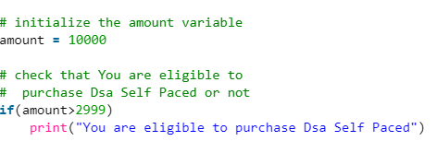
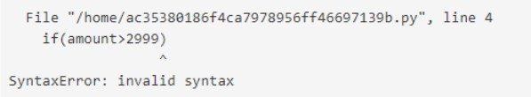

Slide 5
Exceptions
Exceptions: Exceptions are raised when the program is syntactically correct but the code resulted in an error. This error does not stop the execution of the program, however, it changes the normal flow of the program.
Example:-
# initialize the amount variable
marks = 10000
# perform division with 0
a = marks / 0
print(a)

Slide 6
Exceptions are errors that are detected during execution. Whenever there is an error in a program, exceptions are raised.
If these exceptions are not handled, it drives the program into a halt state. Exception handling is required to prevent the program from terminating abruptly.
In python, an exception is a class that represents error.

Slide 7
Why Exception Handling
Exceptions are convenient in many ways for handling errors and special conditions in a program. When you think that you have a code which can produce an error then you can use exception handling.
Exceptions can be unexpected or in some cases, a developer might expect some disruption in the code flow due to an exception that might come up in a specific scenario. Either way, it needs to be handled.

Slide 8
The cause of an exception is often external to the program itself.
For example, an incorrect input, a malfunctioning IO device etc.
Because the program abruptly terminates on encountering an exception, it may cause damage to system resources, such as files.
Hence, the exceptions should be properly handled so that an abrupt termination of the program is prevented.

Slide 9
Common Exceptions in Python
we need to understand what some of the common exceptions that python throws are.
All the inbuilt exceptions in python are inherited from the common ‘Exception’ class.
Common Examples of Exception:
Division by Zero
Accessing a file which does not exist.
Addition of two incompatible types
Trying to access a non-existent index of a sequence

Slide 10
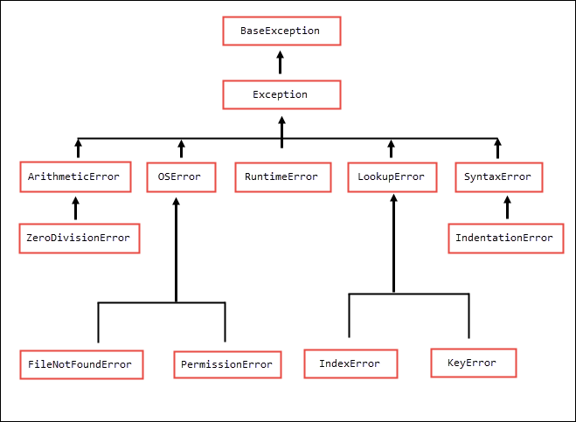

Slide 11
Exception Name | Description
Exception | All exceptions inherit this class as the base class for all exceptions.
ArithmeticError | Errors that occur during numeric calculation are inherited by it.
OverflowError | When a calculation exceeds the max limit for a specific numeric data type
ZeroDivisionError | Raised when division or modulo by zero takes place.

Slide 12
AttributeError | Raised in case of failure of attribute assignment
NameError | Raised when an identifier is not found in the local or non-local or global scope.
SyntaxError | Raised when there is an error in python syntax.
IndentationError | Raised when indentation is not proper
TypeError | Raised when a specific operation of a function is triggered for an invalid data type

Slide 13
ValueError | Raised when invalid values are provided to the arguments of some builtIn function for a data type that has a valid type of arguments.
RuntimeError | Raised when an error does not fall into any other category
NotImplementedError | Raised when an abstract method that needs to be implemented in an inherited class is not actually implemented.

Slide 14
What is Exception Handling in Python?
Python just like any other programming language provides us with a provision to handle exceptions. And that is by try & except block.
Try block allows us to write the code that is prone to exceptions or errors.
If any exception occurs inside the try block, the except block is triggered, in which you can handle the exception as now the code will not go into a halt state but the control will flow into the except block where it can be manually handled.

Slide 15
Any critical code block can be written inside a try clause.
Once the expected or unexpected exception is raised inside this try, it can be handled inside the except clause (This ‘except’ clause is triggered when an exception is raised inside ‘try’), as this except block detects any exception raised in the try block.
By default, except detects all types of exceptions, as all the built-in exceptions in python are inherited from common class Exception.
Syntax:-
try:
# critical statement
except:
# Executed if we get an error in the try block
# Handle exception here

Slide 16
Try and except go hand in hand i.e. the syntax is to write and use both of them. Writing just try or except will give an error.
Example:-
def divideNos(a, b):
return a/b
try:
divideNos(10, 0)
except:
print('some exception occurred')

Slide 17
when a python interpreter raises an exception, it is in the form of an object that holds information about the exception type and message.
Also, every exception type in python inherits from the base class Exception.
Example:-
def divideNos(a, b):
return a/b
try:
divideNos(10, 0)
# Any exception raised by the python interpreter, is inherited by the base class ‘Exception’, hence any exception raised in the try block will be detected and collected further in the except block for handling.
except Exception as e:
print(e) # as e is an object of type Exception, Printing here to see what message it holds.
print(e.__class__)

Slide 18
Keyword for Exception Handling
Try
Except
Raise
Else
Finally

Slide 19
Catching Specific Exceptions in Python
we caught the exception that was being raised in the try block, but the except blocks are going to catch all the exceptions that try might raise.
Well, it’s considered a good practice to catch specific types of exceptions and handle them accordingly.
And yes, try can have multiple except blocks. We can also use a tuple of values in an except to receive multiple specific exception types.

Slide 20
def divideNos(a, b):
return a/b # An exception might raise here if b is 0 (ZeroDivisionError)
try:
a = input('enter a:')
b = input('enter b:')
print('after division', divideNos(a, b))
a = [1, 2, 3]
print(a[3]) # An exception will raise here as size of array ‘a’ is 3 hence is accessible only up until 2nd index
# if IndexError exception is raised
except IndexError:
print('index error')
# if ZeroDivisionError exception is raised
except ZeroDivisionError:
print('zero division error')

Slide 21
def divideNos(a, b):
return a/b
try:
a = int(input('enter a:'))
b = int(input('enter b:'))
print('after division', divideNos(a,b))
a = [1, 2, 3]
print(a[3])
except (IndexError, ZeroDivisionError):
print('index error OR zero division error')

Slide 22
Only one of the except blocks is triggered when an exception is raised.
Consider an example where we have one except as except IndexError and another as except(IndexError, ZeroDivisionError) then the one written first will trigger.

Slide 23
Raising Custom Exceptions
Even though exceptions in python are automatically raised in runtime when some error occurs.
Custom and predefined exceptions can also be thrown manually by raising it for specific conditions or a scenario using the raise keyword.
A custom exception is an exception that a programmer might raise if they have a requirement to break the flow of code in some specific scenario or condition
String messages supporting the reasons for raising an exception can also be provided to these custom exceptions.

Slide 24
Syntax to Raise an Exception
try:
# on some specific condition or otherwise
raise SomeError(OptionalMsg)
Except SomeError as e:
# Executed if we get an error in the try block
# Handle exception ‘e’ accordingly

Slide 25
def isStringEmpty(a):
if(type(a)!=str):
raise TypeError('a has to be string')
if(not a):
raise ValueError('a cannot be null')
a.strip()
if(a == ' '):
return False
return True
try:
a = 123
print('isStringEmpty:', isStringEmpty(a))
except ValueError as e:
print('ValueError raised:', e)
except TypeError as e:
print('TypeError raised:', e)

Slide 26
try except and ELSE!
Sometimes you might have a use case where you want to run some specific code only when there are no exceptions.
For such scenarios, the else keyword can be used with the try block.
Note that this else keyword and its block are optional.
Syntax with Else:
try:
# on some specific condition or otherwise
raise SomeError(OptionalMsg)
except SomeError as e:
# Executed if we get an error in the try block
# Handle exception ‘e’ accordingly
else
# Executed if no exceptions are raised

Slide 27
When an exception is not raised, it flows into the optional else block.
Example:-
try:
b = 10
c = 2
a = b/c
print(a)
except:
print('Exception raised')
else:
print('no exceptions raised')

Slide 28
In the above code, As both the inputs are greater than 0 which is not a risk to DivideByZeroException,
hence try block won’t raise any exception and hence ‘except’ block won’t be triggered.
And only when the control doesn’t flow to the except block, it flows to the else block.
Further handling can be done inside this else block if there is something you want to do.

Slide 29
Try Clause with Finally
Finally is a keyword that is used along with try and except, when we have a piece of code that is to be run irrespective of if try raises an exception or not.
Code inside finally will always run after try and except.

Slide 30
Example: try:
temp = [1, 2, 3]
temp[4]
except Exception as e:
print('in exception block: ', e)
else:
print('in else block')
finally:
print('in finally block')

Slide 31
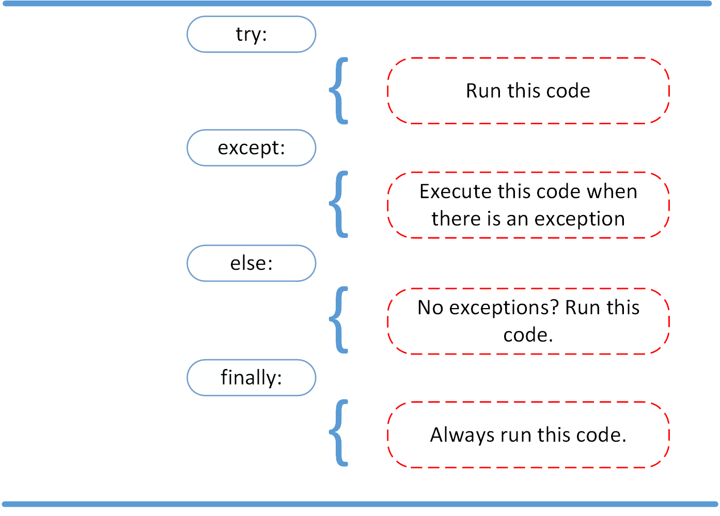

Slide 32
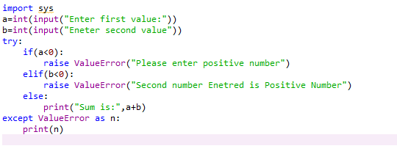
Demonstration-I

Slide 33
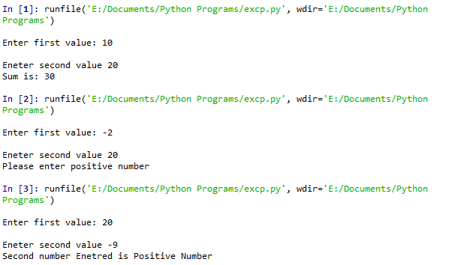
Output

Slide 34
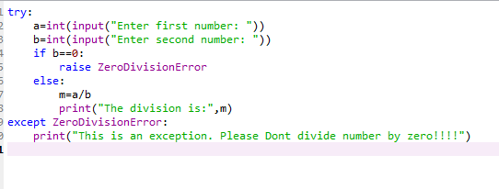
Demonstration-II

Slide 35
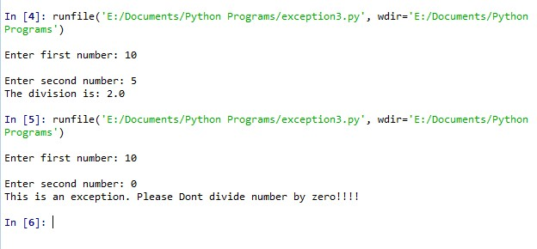
Output

Slide 36
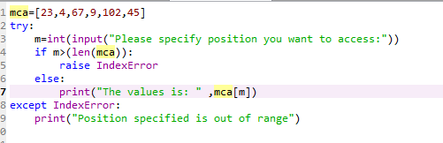
Demonstration-III

Slide 37
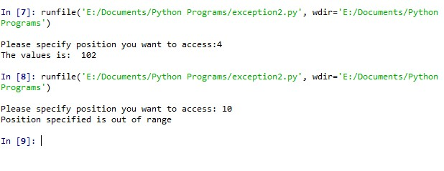
Output

Slide 38
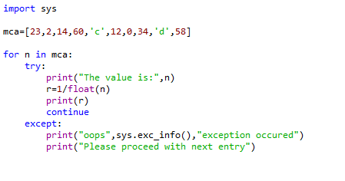
Demonstration-IV

Slide 39
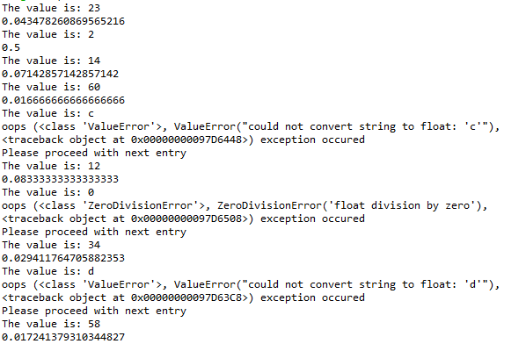
Output

Slide 40
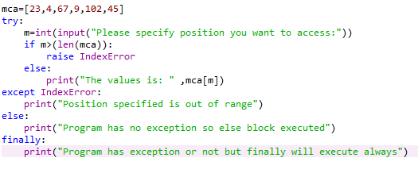
Demonstration-V

Slide 41
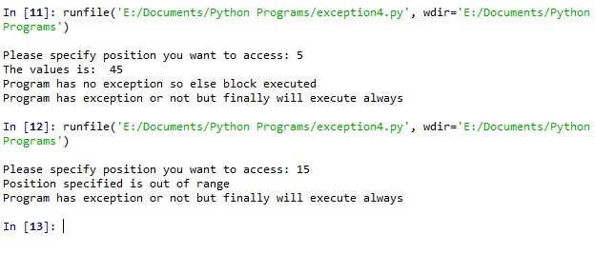
Output

Slide 42
Customized Exception
Python has numerous built-in exceptions that force your program to output an error when something in the program goes wrong.
However, sometimes you may need to create your own custom exceptions that serve your purpose.
In Python, users can define custom exceptions by creating a new class. This exception class has to be derived, either directly or indirectly, from the built-in Exception class. Most of the built-in exceptions are also derived from this class.

Slide 43
When we are developing a large Python program, it is a good practice to place all the user-defined exceptions that our program raises in a separate file.
Many standard modules do this. They define their exceptions separately as exceptions.py or errors.py (generally but not always).
User-defined exception class can implement everything a normal class can do, but we generally make them simple and concise.
Most implementations declare a custom base class and derive others exception classes from this base class.

Slide 44
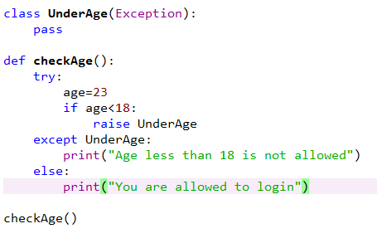

Slide 45
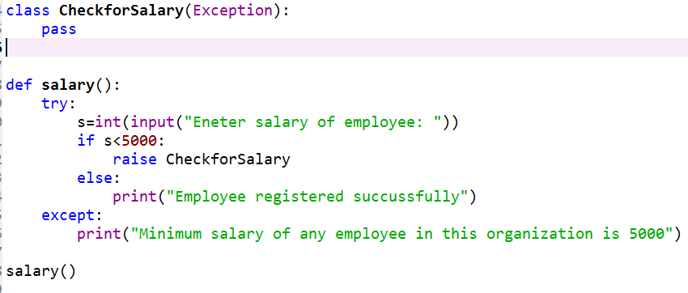

Slide 46
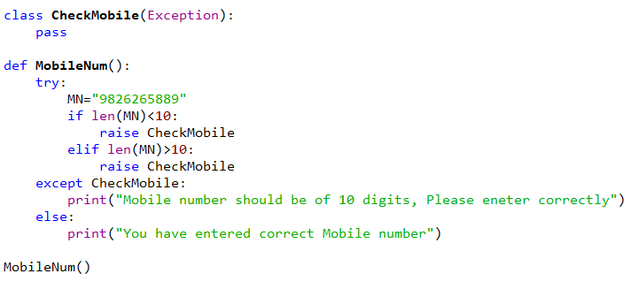

Slide 47
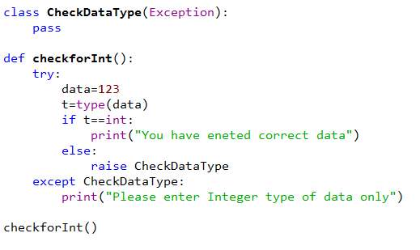

Slide 48
# define Python user-defined exceptions
class Error(Exception):
"""Base class for other exceptions"""
pass
class ValueTooSmallError(Error):
"""Raised when the input value is too small"""
pass
class ValueTooLargeError(Error):
"""Raised when the input value is too large"""
pass
# you need to guess this number
number = 10

Slide 49
# user guesses a number until he/she gets it right
while True:
try:
i_num = int(input("Enter a number: "))
if i_num < number:
raise ValueTooSmallError
elif i_num > number:
raise ValueTooLargeError
break
except ValueTooSmallError:
print("This value is too small, try again!")
print()
except ValueTooLargeError:
print("This value is too large, try again!")
print()
print("Congratulations! You guessed it correctly.")

Slide 50
Multithreading in Python

Slide 51
Introduction
A thread is the smallest unit of execution with the independent set of instructions.
It is a part of the process and operates in the same context sharing program’s runnable resources like memory.
In the computer system, an Operating System achieves multitasking by dividing the process into threads.
A thread is a lightweight process that ensures the execution of the process separately on the system
For Example, when you are playing a game on your PC, the game as a whole is a single process, but it consists of several threads responsible for playing the music, taking input from the user, running the opponent synchronously, etc. All these are separate threads responsible for carrying out these different tasks in the same program.

Slide 52
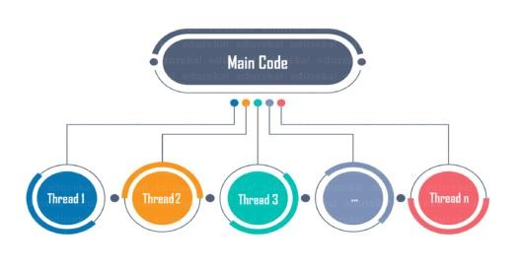

Slide 53
Introduction to processes and threads
Suppose that you have a simple Python program:
x = 10
y = 20
z = x + y
Computers don’t understand Python. They only understand machine code, which is a set of instructions containing zero and one.
Therefore, you need a Python interpreter to execute this Python program that translates the Python code to machine code.
When you execute the python app.py command, Python interpreter converts the app.py into machine code.
The operating system (OS) needs to load the program into the memory (RAM) to run the program.
Once the OS loads the program to memory, it moves the instructions to the CPU for execution via bus.

Slide 54
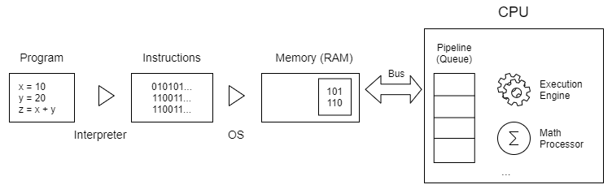
In general, the OS moves the instructions to a queue, also known as a pipeline. Then, the CPU will execute the instructions from the pipeline.
By definition, a process is an instance of the program running on a computer. And a thread is a unit of execution within a process.
The following picture illustrates the flow of running a program in Python on a computer:

Slide 55
So far, you’ve learned how to develop a program that has one process with one thread. Therefore, the terms process and thread are often used interchangeably sometimes.
Typically, a program may have one or more processes. And a process can have one or more threads.

Slide 56
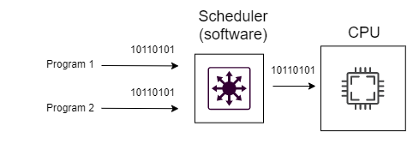
Single-core processors
In the past, a CPU has only one core. In other words, it can run only a single thread at one time.
To execute multiple threads “at the same time”, the OS uses a software component called scheduler:

Slide 57
The scheduler is like a switch that handles process scheduling. The main task of the scheduler is to select the instructions and submit them for execution regularly.
The scheduler switches between processes so fast (about 1ms) that you feel the computer can run multiple processes simultaneously.
When a program has multiple threads, it’s called a multi-threaded application. Otherwise, it’s called a single-threaded application.
Multithreading is the ability of a single-core CPU to provide multiple threads of execution concurrently supported by the scheduler of the OS.

Slide 58
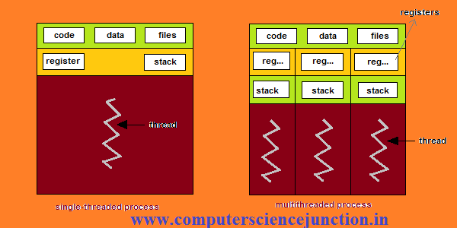

Slide 59
Multiple-core processors
Today, the CPU often has multiple cores, e.g., two cores (dual-core) and four cores (quad-core).
A dual-core CPU can execute exactly two processes, and a quad-core CPU can execute four processes simultaneously.
Generally, the more cores the CPU has, the more processes it can truly execute simultaneously.
Multiprocessing uses a multi-core CPU within a single computer, which indeed executes multiple processes in parallel.

Slide 60
Process
In computing, a process is an instance of a computer program that is being executed. Any process has 3 basic components:
An executable program.
The associated data needed by the program (variables, work space, buffers, etc.)
The execution context of the program (State of process)
A process is basically the program in execution. When you start an application in your computer (like a browser or text editor), the operating system creates a process.
A thread is an entity within a process that can be scheduled for execution. Also, it is the smallest unit of processing that can be performed in an OS (Operating System).

Slide 61
To understand processes and threads, consider this scenario: An .exe file on your computer is a program. When you open it, the OS loads it into memory, and the CPU executes it. The instance of the program which is now running is called the process.
Every process will have 2 fundamental components:
The Code
The Data
Now, a process can contain one or more sub-parts called threads. This depends on the OS architecture. You can think about a thread as a section of the process which can be executed separately by the operating system.
In other words, it is a stream of instructions which can be run independently by the OS. Threads within a single process share the data of that process and are designed to work together for facilitating parallelism.

Slide 62
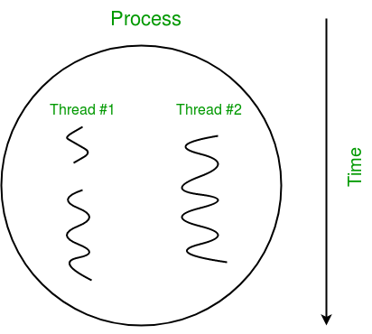

Slide 63
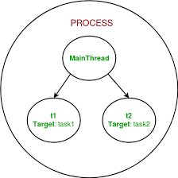

Slide 64
Thread
In simple words, a thread is a sequence of such instructions within a program that can be executed independently of other code. For simplicity, you can assume that a thread is simply a subset of a process!
A thread contains all this information in a Thread Control Block (TCB):
Thread Identifier: Unique id (TID) is assigned to every new thread
Stack pointer: Points to thread’s stack in the process. Stack contains the local variables under thread’s scope.
Program counter: a register which stores the address of the instruction currently being executed by thread.
Thread state: can be running, ready, waiting, start or done.
Thread’s register set: registers assigned to thread for computations.
Parent process Pointer: A pointer to the Process control block
(PCB) of the process that the thread lives on.

Slide 65
Multiple Threads
Multiple threads can exist within one process where:
Each thread contains its own register set and local variables
(stored in stack).
All thread of a process share global variables (stored in heap) and the program code.
Consider the diagram below to understand how multiple
threads exist in memory:

Slide 66
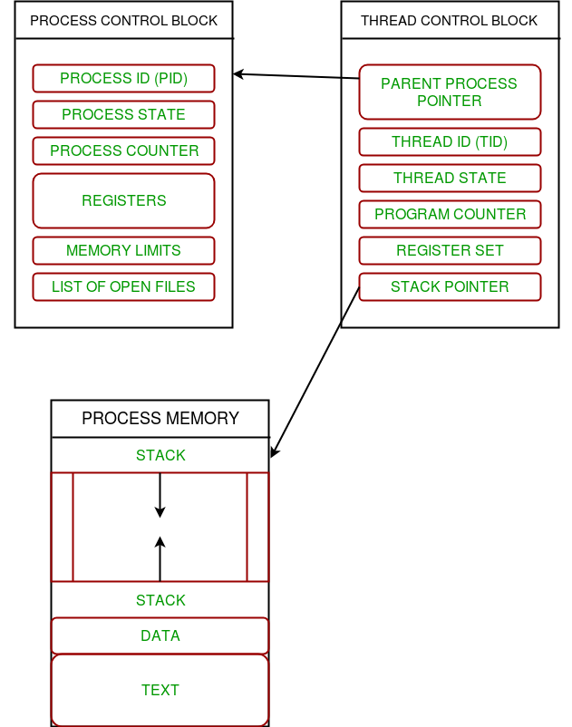

Slide 67
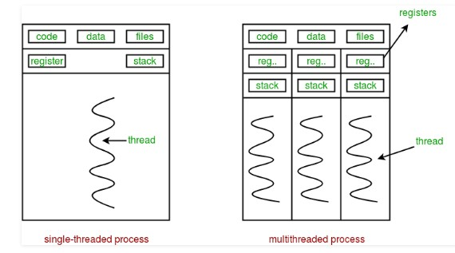

Slide 68
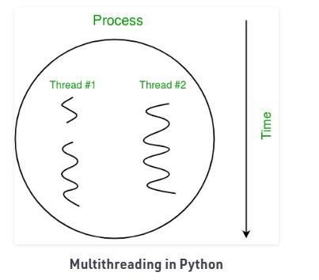

Slide 69
When to Use
Multithreading is very useful for saving time and improving performance, but it cannot be applied everywhere. In the previous example, the music thread is independent of the thread that takes your input and the thread that takes your input is independent of the thread that runs your opponent. These threads run independently because they are not inter-dependent.
Therefore, multithreading can be used only when the dependency between individual threads does not exist.

Slide 70
Benefits of Multithreading
It ensures effective utilization of computer system
resources.
Multithreaded applications are more responsive.
It shares resources and its state with sub-threads (child) which makes it more economical.
It makes the multiprocessor architecture more effective due
to similarity.
It saves time by executing multiple threads at the same time.
The system does not require too much memory to store
multiple threads.

Slide 71
Applications
Web Browsers - A web browser can download any number of files and web pages (multiple tabs) at the same time and still lets you continue browsing. If a particular web page cannot be downloaded, that is not going to stop the web browser from downloading other web pages.
Web Servers - A threaded web server handles each request with a new thread. There is a thread pool and every time a new request comes in, it is assigned to a thread from the thread pool.
Computer Games - You have various objects like cars, humans, birds which are implemented as separate threads. Also playing the background music at the same time as playing the game is an example of multithreading.

Slide 72
Text Editors - When you are typing in an editor, spell-checking, formatting of text and saving the text are done concurrently by multiple threads. The same applies for Word processors also.
IDE - IDEs like Android Studio run multiple threads at the same time. You can open multiple programs at the same time. It also gives suggestions on the completion of a command which is a separate thread.

Slide 73
What is Multithreading in Python?
Multithreading in Python programming is a well-known technique in which multiple threads in a process share their data space with the main thread which makes information sharing and communication within threads easy and efficient.
Threads are lighter than processes.
Multi threads may execute individually while sharing their process resources.
The purpose of multithreading is to run multiple tasks and function cells at the same time.

Slide 74
How to create thread in python
Threads in Python can be created in three ways:
Without creating a class
By extending Thread class
Without extending Thread class
There are two main modules of multithreading used to handle threads in Python
The thread module
The threading module

Slide 75
Python 2.x used to have the <thread> module. But it got deprecated in Python 3.x and renamed to <_thread> module for backward compatibility.
The principal difference between the two modules is that the module <_thread> implements a thread as a function.
On the other hand, the module <threading> offers an object-oriented approach to enable thread creation.

Slide 76
Thread Module
If you decide the <thread> module to apply in your program, then use the following method to create threads.
#Syntax
thread.start_new_thread(function, args[,kwargs] )
This method is quite efficient and straightforward for creating threads.
You can use it to run programs in both Linux and Windows.

Slide 77
This method starts a new thread and returns its identifier.
It’ll invoke the function specified as the “function” parameter with the passed list of arguments.
When the <function> returns, the thread would silently exit.
Here, args is a tuple of arguments; use an empty tuple to call <function> without any arguments.
The optional <kwargs> argument specifies the dictionary of keyword arguments.

Slide 78
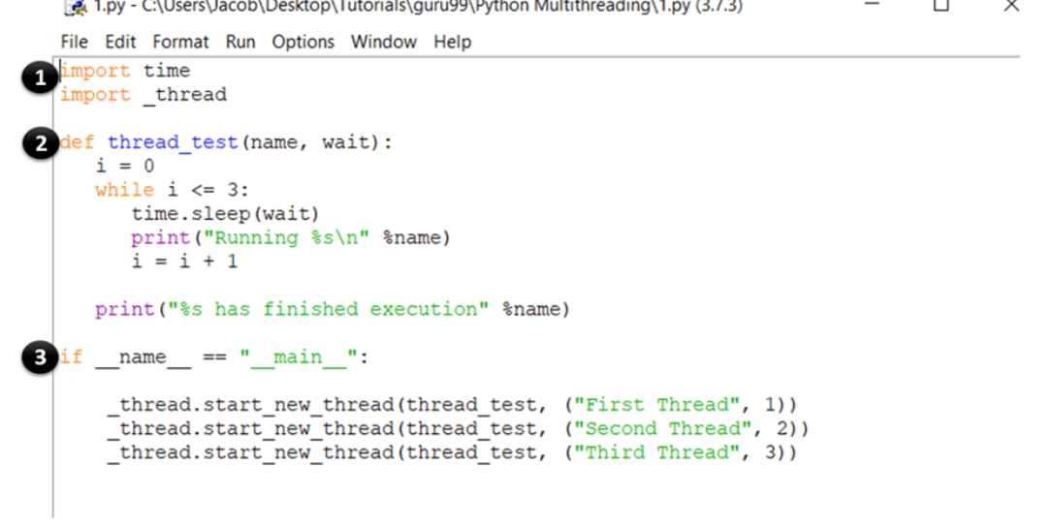

Slide 79
These statements import the time and thread module which are used to handle the execution and delaying of the Python threads.
Here, you have defined a function called thread_test, which will be called by the start_new_thread method. The function runs a while loop for four iterations and prints the name of the thread which called it. Once the iteration is complete, it prints a message saying that the thread has finished execution.
This is the main section of your program. Here, you simply call the start_new_thread method with the thread_test function as an argument.This will create a new thread for the function you pass as argument and start executing it. Note that you can replace this (thread_test) with any other function which you want to run as a thread.

Slide 80
Threading Module
The latest <threading> module provides rich features and better support for threads than the legacy <thread> module
The <threading> module is an excellent example of Python Multithreading.
The <threading> module combines all the methods of the <thread> module and exposes few additional methods.

Slide 81
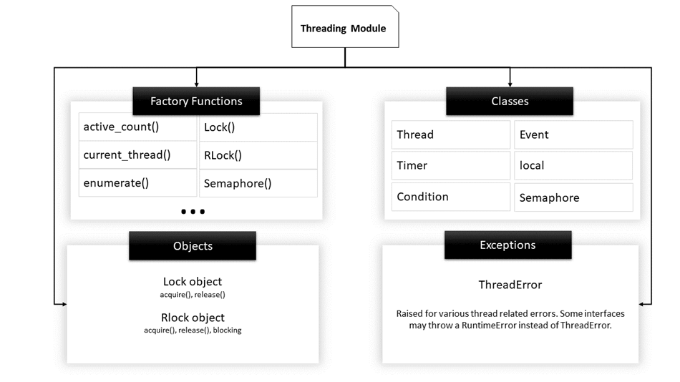

Slide 82
Function Name | Description
activeCount() | Returns the count of Thread objects which are still alive
currentThread() | Returns the current object of the Thread class.
enumerate() | Lists all active Thread objects.
isDaemon() | Returns true if the thread is a daemon.
isAlive() | Returns true if the thread is still alive.

Slide 83
Thread Class methods
start() | Starts the activity of a thread. It must be called only once for each thread because it will throw a runtime error if called multiple times.
run() | This method denotes the activity of a thread and can be overridden by a class that extends the Thread class.
join() | It blocks the execution of other code until the thread on which the join() method was called gets terminated.

Slide 84
Steps to implement threads using the threading module
You may follow the below steps to implement a new thread using the <threading> module.
Construct a subclass from the <Thread> class.
Override the <__init__(self [,args])> method to supply arguments as per requirements.
Next, override the <run(self [,args])> method to code the business logic of the thread.
Once you define the new <Thread> subclass, you have to instantiate it to start a new thread. Then, invoke the <start()> method to initiate it. It will eventually call the <run()> method to execute the business logic.

Slide 85
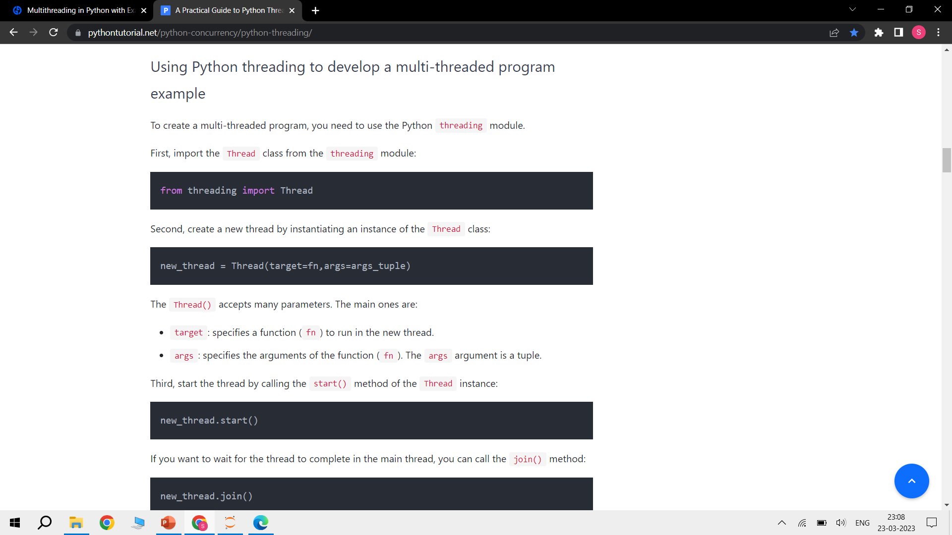

Slide 86
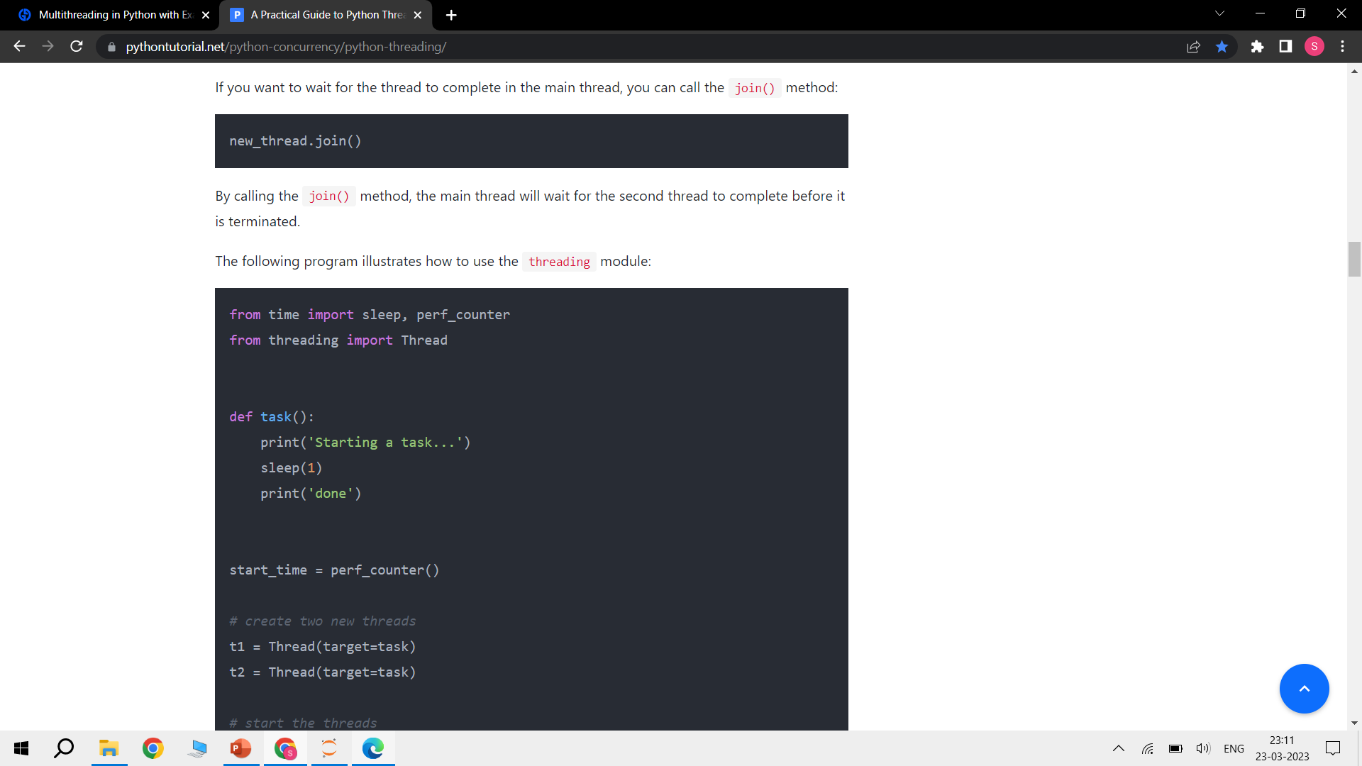

Slide 87
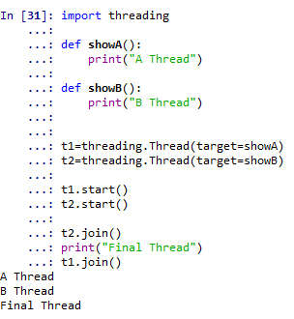

Slide 88
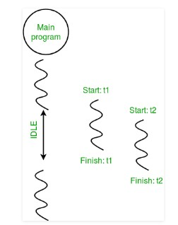

Slide 89
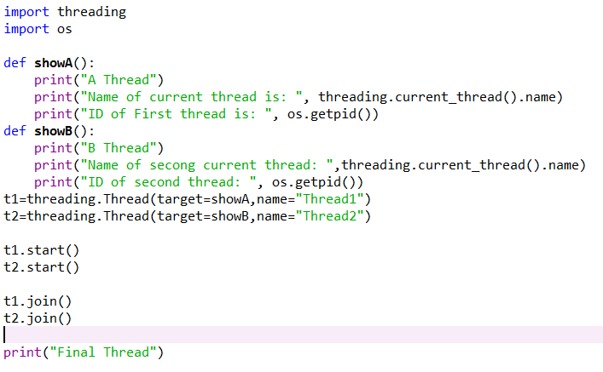

Slide 90
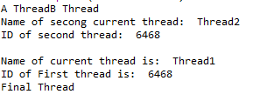

Slide 91
Functions of Thread Class
Method | Description
activeCount() | Returns the count of Thread objects which are still alive
currentThread() | Returns the current object of the Thread class.
enumerate() | Lists all active Thread objects.
isAlive() | Returns true if the thread is still alive.
start() | Starts the activity of a thread. It must be called only once for each thread because it will throw a runtime error if called multiple times.

Slide 92
Functions of Thread Class
Method | Description
run() | This method denotes the activity of a thread and can be overridden by a class that extends the Thread class.
join() | It blocks the execution of other code until the thread on which the join() method was called gets terminated.
getName(): | The getName() method retrieves the name of a thread.
setName(): | The setName() method updates the name of a thread.

Slide 93
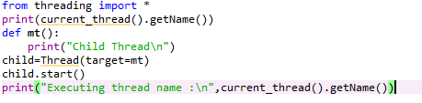
Without Creating a Class
Multithreading in Python can be accomplished without
creating a class as well

Slide 94

Output

Slide 95
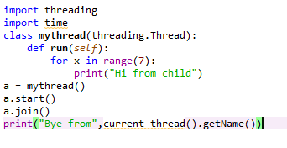
By Extending Thread Class
When a child class is created by extending the Thread class, the child class represents that a new thread is executing some task. When extending the Thread class, the child class can override only two methods i.e. the __init () method and the run() method. No other method can be overridden other than these two methods.

Slide 96
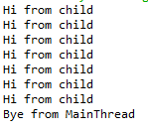
Output

Slide 97
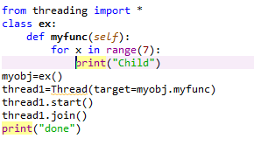
Without Extending Thread class
To create a thread without extending the Thread class

Slide 98

Output

Slide 99
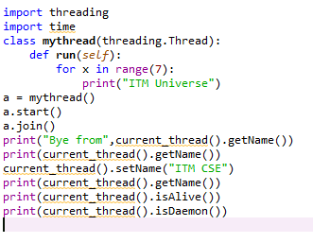
Demonstration-I

Slide 100
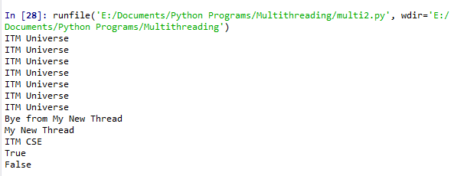
Output

Slide 101
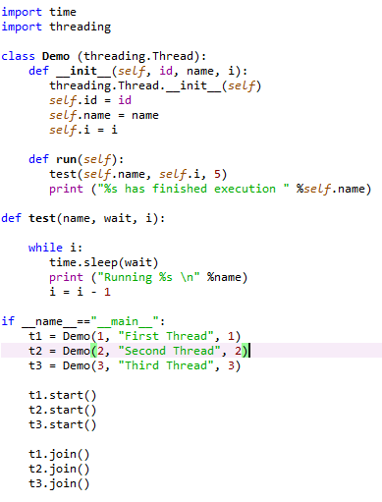
Demonstration-II

Slide 102
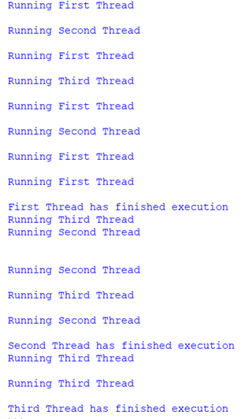
Output

Slide 103
Deadlocks and Race conditions
Before learning about deadlocks and race conditions, it'll be helpful to understand a few basic definitions related to concurrent programming:
Critical Section : It is a fragment of code that accesses or modifies shared variables and must be performed as an atomic transaction.
The critical section is a code segment where the shared variables can be accessed.
An atomic action is required in a critical section i.e. only one process can execute in its critical section at a time.
All the other processes have to wait to execute in their critical sections.

Slide 104
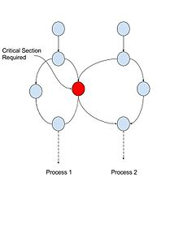

Slide 105
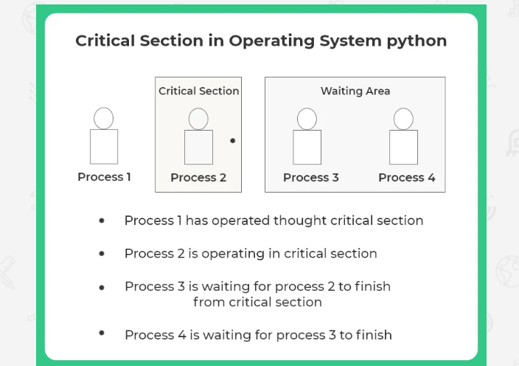

Slide 106
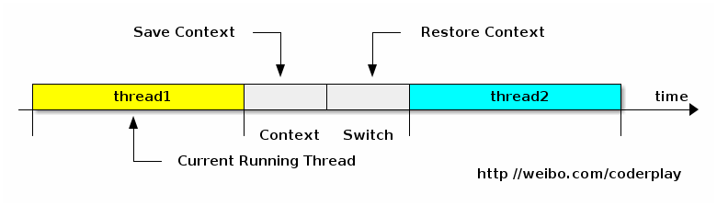
2. Context Switch : It is the process that a CPU follows to store the state of a thread before changing from one task to another so that it can be resumed from the same point later.
As the process is running, another process arrives in the ready queue, which has a high priority of completing its task using CPU. Here we used context switching that switches the current process with the new process requiring the CPU to finish its tasks.

Slide 107
Deadlock
Deadlock is a situation where a set of processes are blocked because each process is holding a resource and waiting for another resource acquired by some other process.
Consider an example when two trains are coming toward each other on the same track and there is only one track, none of the trains can move once they are in front of each other. A similar situation occurs in operating systems when there are two or more processes that hold some resources and wait for resources held by other(s).
For example, in the below diagram, Process 1 is holding Resource 1 and waiting for resource 2 which is acquired by process 2, and process 2 is waiting for resource 1.

Slide 108
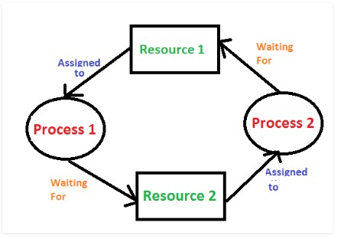

Slide 109
Deadlocks
Deadlocks are the most feared issue that developers face when writing concurrent/multithreaded applications in python. The best way to understand deadlocks is by using the classic computer science example problem known as the Dining Philosophers Problem.
The problem statement for dining philosophers is as follows:
Five philosophers are seated on a round table with five plates of spaghetti (a type of pasta) and five forks, as shown in the diagram.

Slide 110
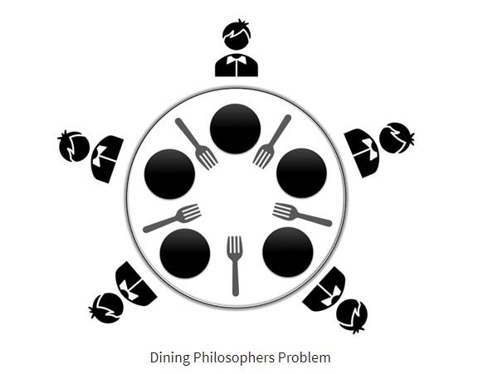

Slide 111
At any given time, a philosopher must either be eating or
thinking.
Moreover, a philosopher must take the two forks adjacent to him (i.e., the left and right forks) before he can eat the spaghetti. The problem of deadlock occurs when all five philosophers pick up their right forks simultaneously.
Since each of the philosophers has one fork, they will all wait for the others to put their fork down. As a result, none of them will be able to eat spaghetti.
Similarly, in a concurrent system, a deadlock occurs when different threads or processes (philosophers) try to acquire the shared system resources (forks) at the same time. As a result, none of the processes get a chance to execute as they are waiting for another resource held by some other process.

Slide 112
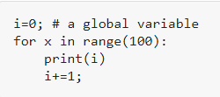
Race Conditions
A race condition is an unwanted state of a program which occurs when a system performs two or more operations simultaneously. For example, consider this simple for loop:

Slide 113
If you create n number of threads which run this code at once, you cannot determine the value of i (which is shared by the threads) when the program finishes execution.
This is because in a real multithreading environment, the threads can overlap, and the value of i which was retrieved and modified by a thread can change in between when some other thread accesses it.
A race condition occurs when two threads try to access a shared variable simultaneously.
The first thread reads the value from the shared variable. The second thread also reads the value from the same shared variable.

Slide 114
Then both threads try to change the value of the shared variable. And they race to see which thread writes a value to the variable last.
The value from the thread that writes to the shared variable last is preserved because it overwrites the value that the previous thread wrote.

Slide 115
Synchronizing threads
To deal with race conditions, deadlocks, and other thread-
based issues, the threading module provides the Lock object.
The idea is that when a thread wants access to a specific resource, it acquires a lock for that resource. Once a thread locks a particular resource, no other thread can access it until the lock is released.
As a result, the changes to the resource will be atomic, and race conditions will be averted.
A lock is a low-level synchronization primitive implemented by
the thread module.

Slide 116
At any given time, a lock can be in one of 2
states: locked or unlocked. It supports two methods:
acquire(): When the lock-state is unlocked, calling the acquire() method will change the state to locked and return. However, If the state is locked, the call to acquire() is blocked until the release() method is called by some other thread.
release(): The release() method is used to set the state to unlocked, i.e., to release a lock. It can be called by any thread, not necessarily the one that acquired the lock.

Slide 117
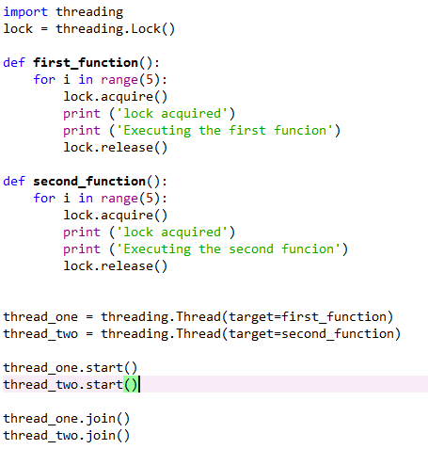

Slide 118


Slide 119
Multithreaded Priority Queue
The Queue module is primarily used to manage to process large amounts of data on multiple threads. It supports the creation of a new queue object that can take a distinct number of items.
The get() and put() methods are used to add or remove items from a queue respectively. Below is the list of operations that are used to manage Queue:
get(): It is used to add an item to a queue.
put(): It is used to remove an item from a queue.
qsize(): It is used to find the number of items in a queue.
empty(): It returns a boolean value depending upon whether the queue is empty or not.
full(): It returns a boolean value depending upon whether the queue is full or not.

Slide 120
A Priority Queue is an extension of the queue with the following properties:
An element with high priority is dequeued before an element with low priority.
If two elements have the same priority, they are served according to their order in the queue

Slide 121
Advantages
Better utilization of resources
Simplifies the code
Allows concurrent and parallel occurrence of various tasks
Reduces the time consumption or response time, thereby, increasing the performance.

Slide 122
Disadvantages
On a single processor system, multithreading won’t hit the speed of computation. The performance may downgrade due to the overhead of managing threads.
Synchronization is needed to prevent mutual exclusion while accessing shared resources. It directly leads to more memory and CPU utilization.
Multithreading increases the complexity of the program, thus also making it difficult to debug.
It raises the possibility of potential deadlocks.
It may cause starvation when a thread doesn’t get regular access to shared resources. The application would then fail to resume its work.

Slide 123



